Slide 1
Introduction to Cloud Computing Unit 1- Day2 Recent trends in Computing
Prashant Kaushal

Slide 2
Recap
Intro
Different sectors
Medical..Cancer detection
Hotel
Marketing
Govt Services
Farming
RealTime BI
EventManagement
Education..eLearning
Transport
Media…real time news
Usage
Consumer
Producer

Slide 3
Computing: Its all about money!!
Really?
Trade , Services, Education, Knowledge
Physical / virtual
Whats in a name
“Amazon WebServices”
SalesForce -> Force -> SalesForce1

Slide 4
Recent Trends
Distributed Computing
Cluster Computing
Grid Computing
Utility Computing
Cloud Computing

Slide 5
Distributed Computing

Slide 6
Cluster Computing

Slide 7
Grid Computing

Slide 8
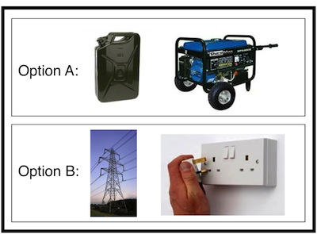
Utility Computing
Utility computing is a service provisioning model in which a service provider makes computing resources and infrastructure management available to the customer as needed, and charges them for specific usage rather than a flat rate.

Slide 9
Cloud Computing

Slide 10
Thanks

